Slide 1
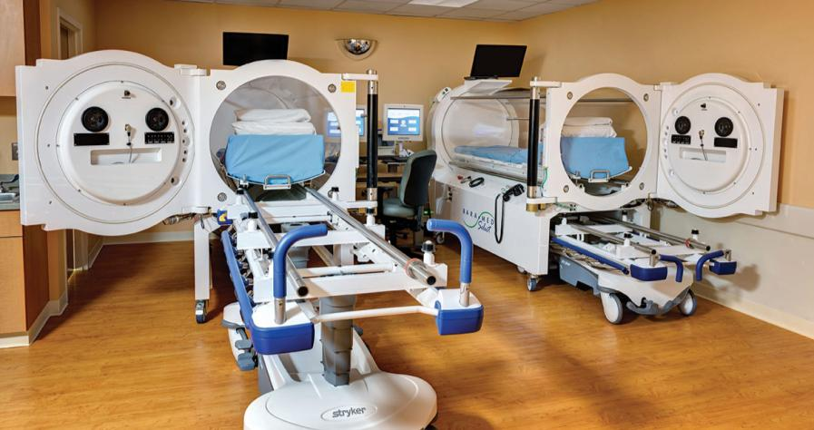

Slide 2
ABOUT ETC
Founded in 1969
Based in Southampton, PA
Approximately 300 employees worldwide
Public company, OTC traded

Slide 3
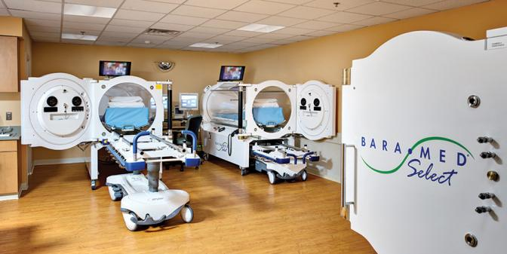
FIRST to produce clinical monoplace hyperbaric chambers with:
Computer based automatic operations
SMOOTH RIDE™ technology for compression & decompression
Patented gurney garage for optimized space usage
700 lb patient capability

Slide 4
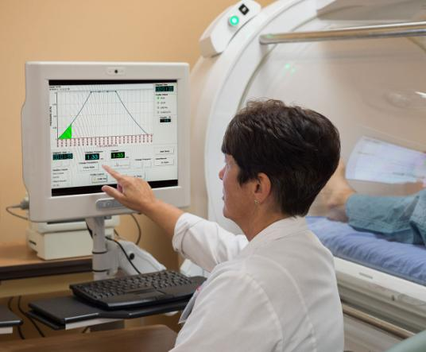
2 Independent
Control Systems
Fourth generation
Windows based
Time proven software
Semi-automatic override
Reusable, precise
treatment protocols
Backup manual pneumatic control capable of running full treatment

Slide 5
O.S.C.A.R.TM
Control and Recordkeeping
Manage treatment protocols and
maintain electronic records
Comprehensive and unassailable
documentation of the procedure
Focus attention on patient care and
management
Improve effectiveness and efficiency
Hard copy printout of treatment record

Slide 6
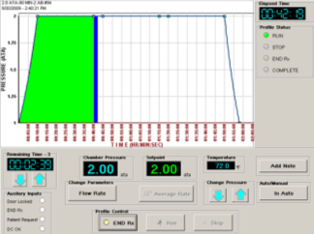
SMOOTH RIDE™
Revolutionary pressure-change technology
Patient friendly pressurization
alternative
Significantly reduce the incidence of
middle ear barotrauma during
compression
More effectively manage patients with
COPD during decompression
Significant reduction of patient rejection
Improved operational timelines

Slide 7
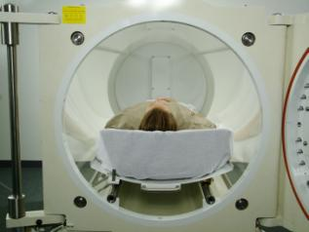
Patient Placement
Greater patient volume in relation to cylinder diameter
Scoop litter
Optimized rail placement
Greater patient room
Accommodates over the 95th
percentile of population

Slide 8
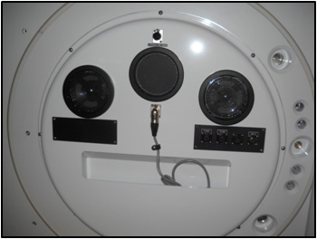
Patient communications
Two internal speakers
Speaker for patient audio pickup or
alternative boom
Boosted microphone for enhanced
communications
Entertainment audio input silenced when operator communicates with patient
External handset for privacy

Slide 9
TRAINING AND EDUCATION

Slide 10
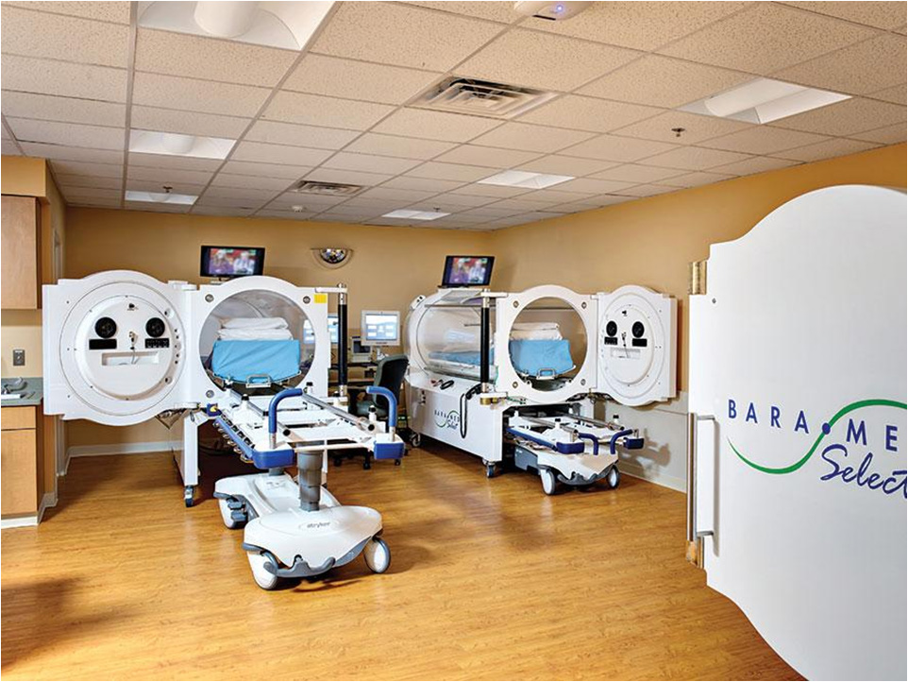
WE ARE: Hyperbaric Oxygen Chambers

